Slide 1
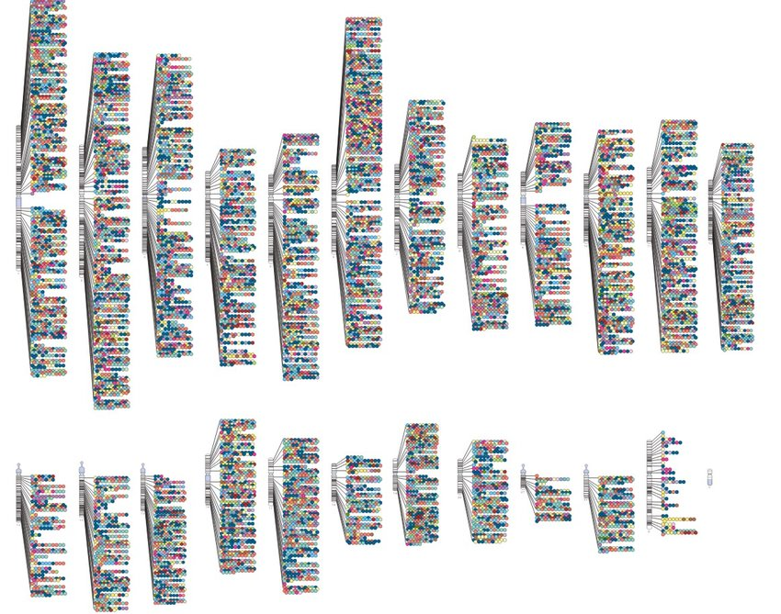
Multi-ancestry gene-based association tests identify novel loci and drug targets in minority populations
Noah Lorincz-Comi, PhD
Genomic Medicine Institute
Feixiong Cheng Lab
October 2nd, 2024
All detected genotype-phenotype associations across 22 chromosomes (GWAS catalog)

Slide 2
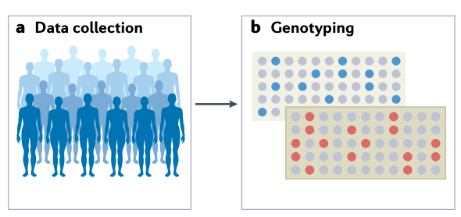
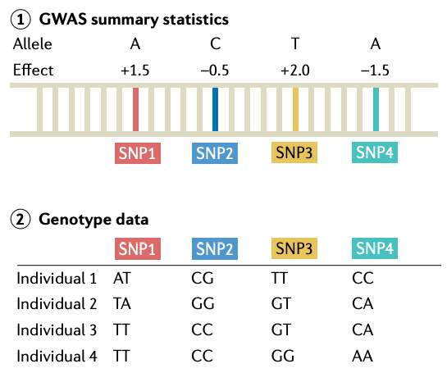
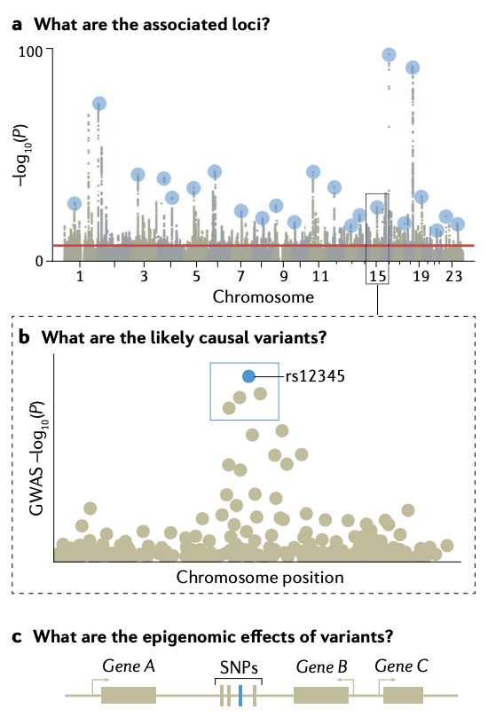

Screening for disease-associated genes
Background
Methods
Results
Conclusions
Genome-wide association studies (GWAS)
(Standard method to screen the genome for disease-associated genes)
(1) Data collection
(2) Genotyping
(3) Estimate disease associations SNP-wise
(4) Infer disease-associated SNPs
SNPs are basic units of human DNA. SNP genotypes in disease patients are compared to those in healthy patients.
Adapted from Uffelmann et al., 2021 (36918594)

Slide 3
Screening for disease-associated genes
Background
Methods
Results
Conclusions
Genome-wide association studies (GWAS)
(Standard method to screen the genome for disease-associated genes)
How are gene-level inferences typically made using GWAS?
(3) Assign most ‘strongly’ disease-associated SNP to its closest gene
(2) Choose a disease-associated region
(1) Estimate disease associations SNP-wise across the entire genome
Gene B
SNPs
Gene A
Gene C
(4) Make gene-level inference
SNPs are basic units of human DNA. SNP genotypes in disease patients are compared to those in healthy patients.
RISK Gene B
SNPs
Gene A
Gene C
Gene B
SNPs
Gene A
Gene C
Adapted from Uffelmann et al., 2021 (36918594)

Slide 4
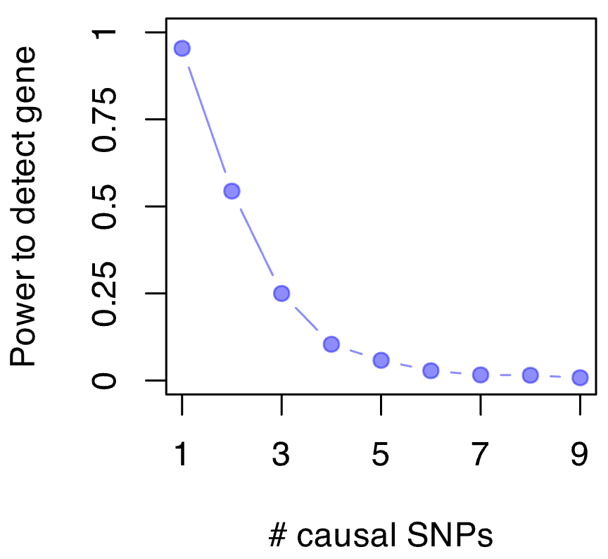
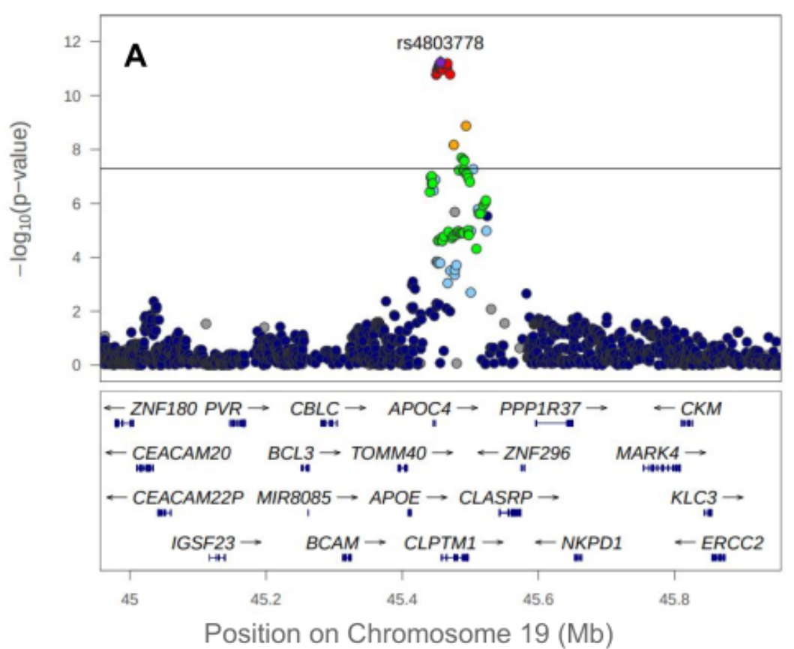
Limits of SNP-based gene inference, gene testing
Background
Methods
Results
Conclusions
SNP-based inference from GWAS
Low power
Relies on one strongly-associated SNP
Can be hard to assign a SNP to a gene
Many gene-dense regions
Gene-based association tests
(Test the gene explicitly using its SNPs)
SNP set C
SNP set B
SNP set A
Gene B
Gene A
Gene C
Shade et al.
(2022)
H₀(B): SNP set B contains no disease-associated SNPs
Test using statistic T(B), sum of correlated chi-squares
Crucial statistical limitation
The entire validity of the inference rests on this
We don’t know the distribution of T(B) | H₀(B)
Inflated false positive/negative rates*
Intense computation to try estimating
*Zhang 2020; Hof 2024;
Hecker 2017; Yurko 2020
Notes:
Shade et al. (2022): https://doi.org/10.1101/2022.12.13.22282475

Slide 5




















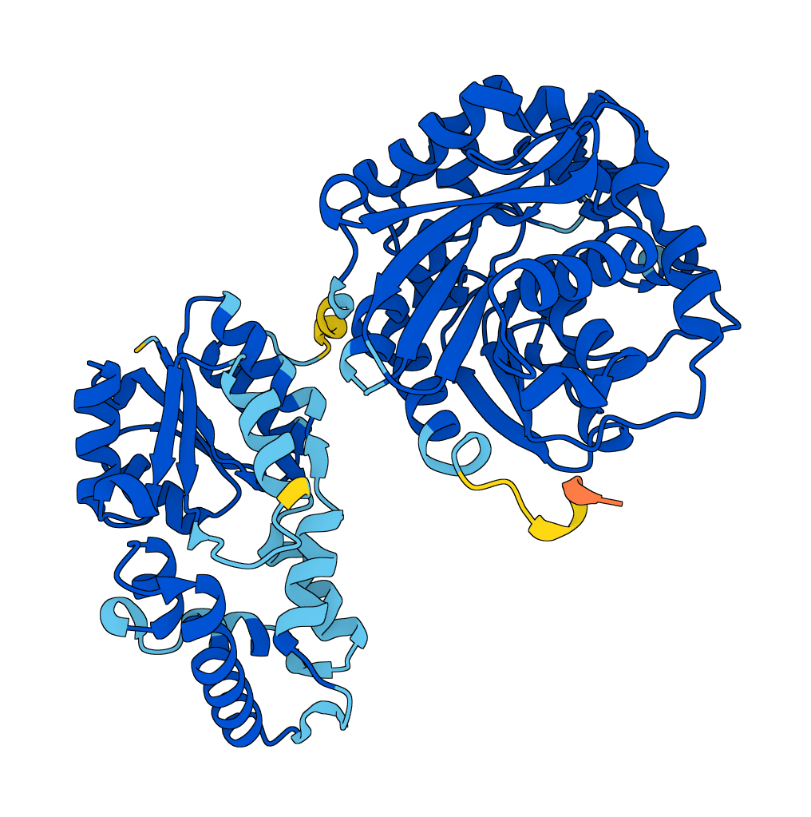


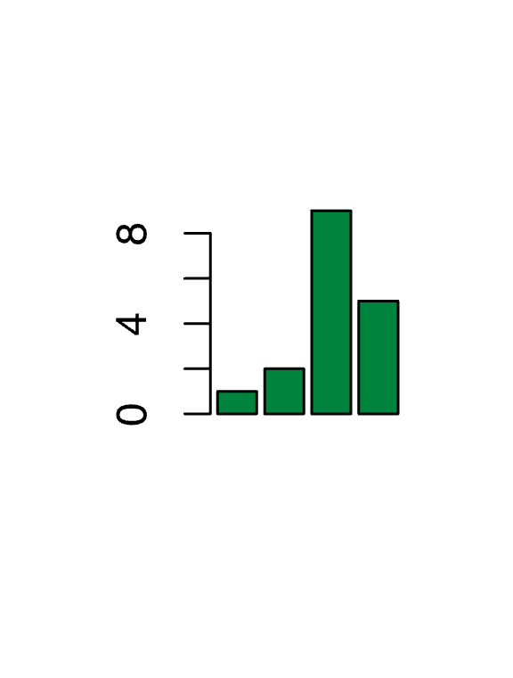


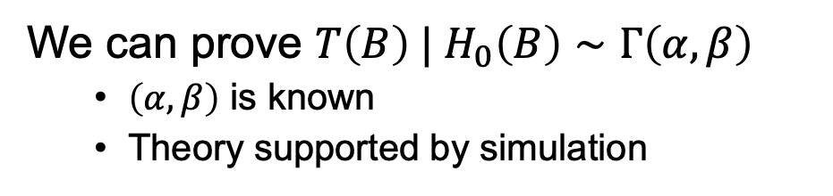
Fixing and extending the current standard
Background
Methods
Results
Conclusions
Fixing the gene-based test (GenT)
Extending gene-based tests
We can prove $T\left(B\right) | H_{0}\left(B\right)∼Γ\left(α,β\right)$
$\left(α,β\right)$ is known
Theory supported by simulation
MuGenT (Multi-ancestry/trait GenT)
Disease
Leverage power across populations
African
SNP set B
E. Asian
European
0 Power 1
Controlled Type I error
Powerful
Gene B
Hispanic
# shared causal SNPs: 0 1 2
S. Asian
Genetic correlation
xGenT (xQTL-integrated GenT)
Causal evidence under some assumptions
Protein abundance
Disease
SNP set B
pQTLs
Confounders
Gene B
eQTLs
Gene expression

Slide 6
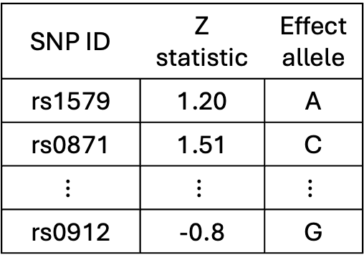
Searching for disease-associated druggable genes
Background
Methods
Results
Conclusions
Data
Summary statistics from disease GWAS
List of genes encoding druggable protein targets
3,369 total; 1.3K high within binding affinity
Summary GWAS data structure
SNP ID | Z statistic | Effect allele
rs1579 | 1.20 | A
rs0871 | 1.51 | C
$$⋮$$ | $$⋮$$ | $$⋮$$
rs0912 | -0.8 | G
 | GWAS samples sizes
 |  | Alzheimer’s disease | ALS | Schizophrenia | Type 2 diabetes
Population | African | - | - | - | 129K
 | E. Asian | - | - | - | 247K
 | European | 480K | 139K | 400K | 752K
 | Hispanic | - | - | - | 73K
 | S. Asian | - | - | - | 42K
Millions of available SNPs
Neighboring SNPs are correlated
Estimated using 1kg Phase 3
Many traits not studied using GWAS in non-European populations

Slide 7
Detecting novel neuropsychiatric genes in Europeans
Background
Methods
Results
Conclusions
Alzheimer’s disease
75
18
Novel druggable gene
+ In a novel locus
ALS
28
15
-log₁₀ gene P-value
(Bonferroni)
Schizophrenia
218
83

Slide 8
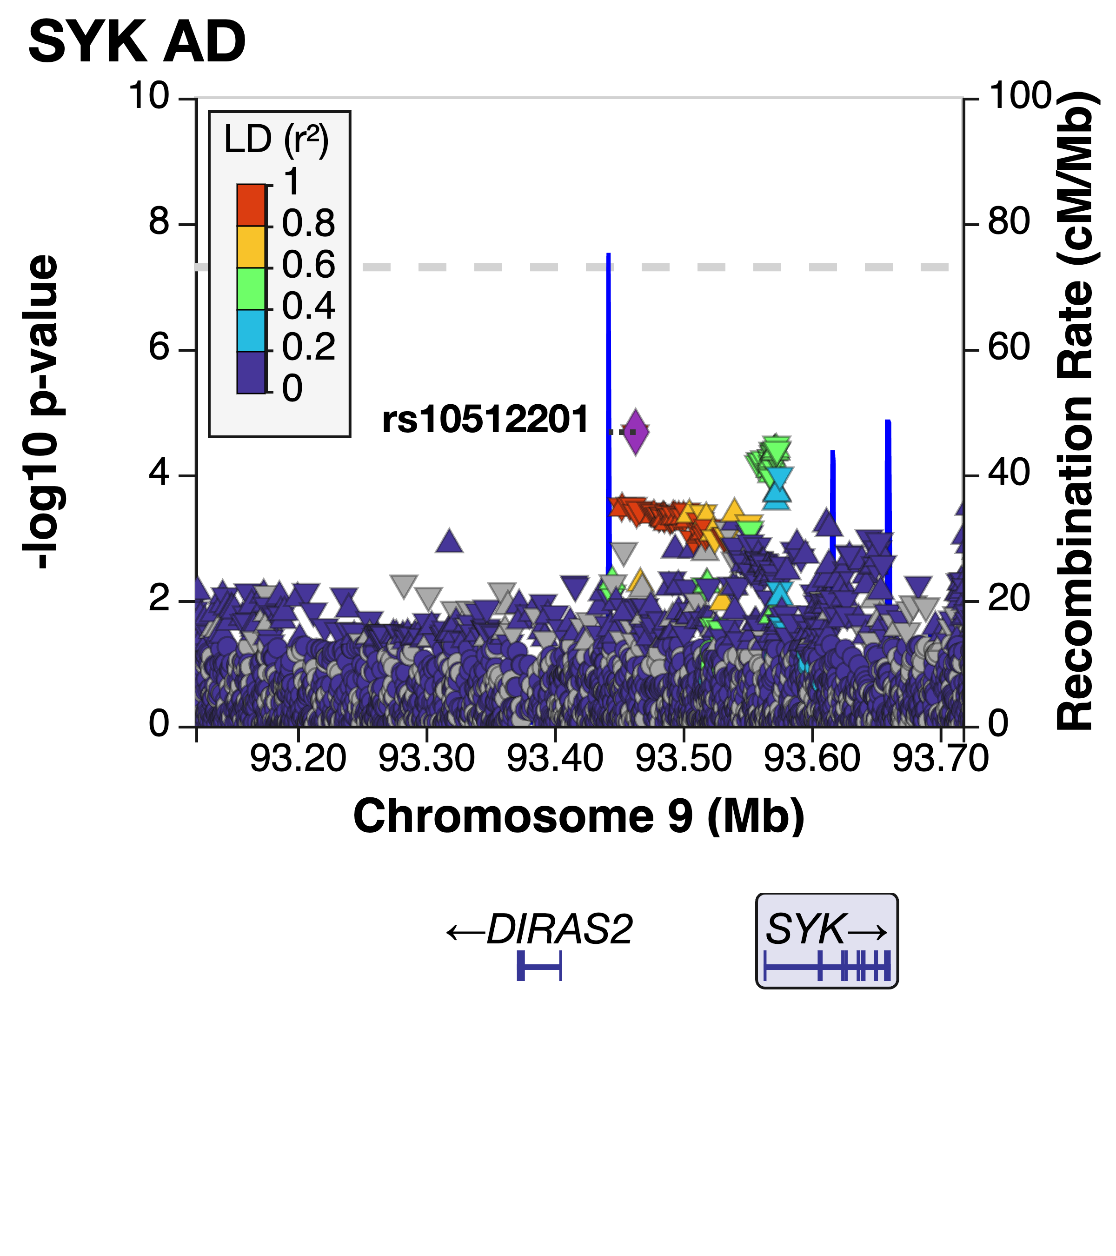
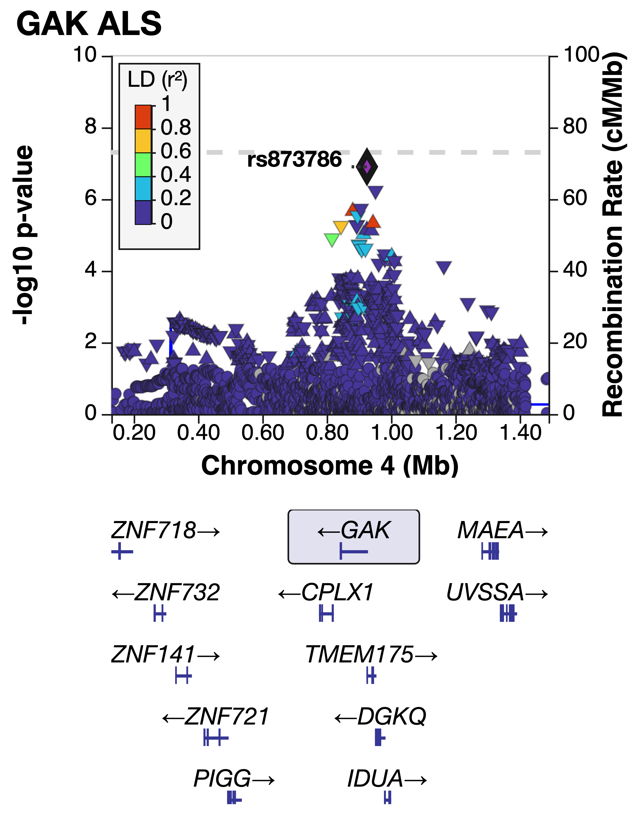
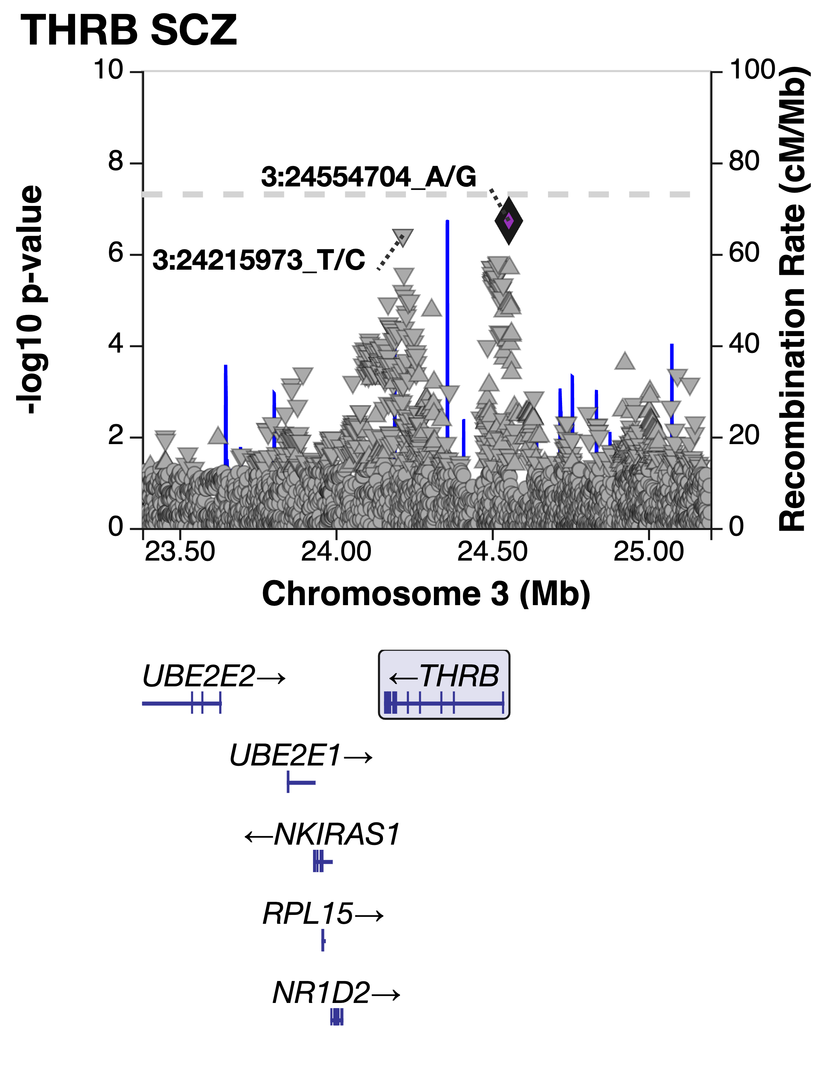
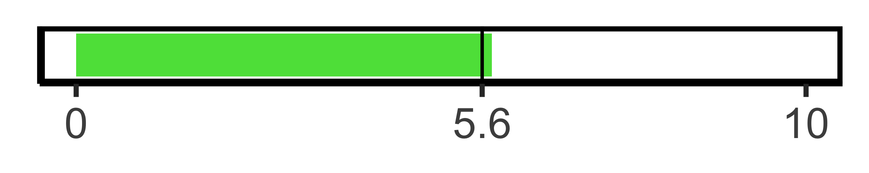
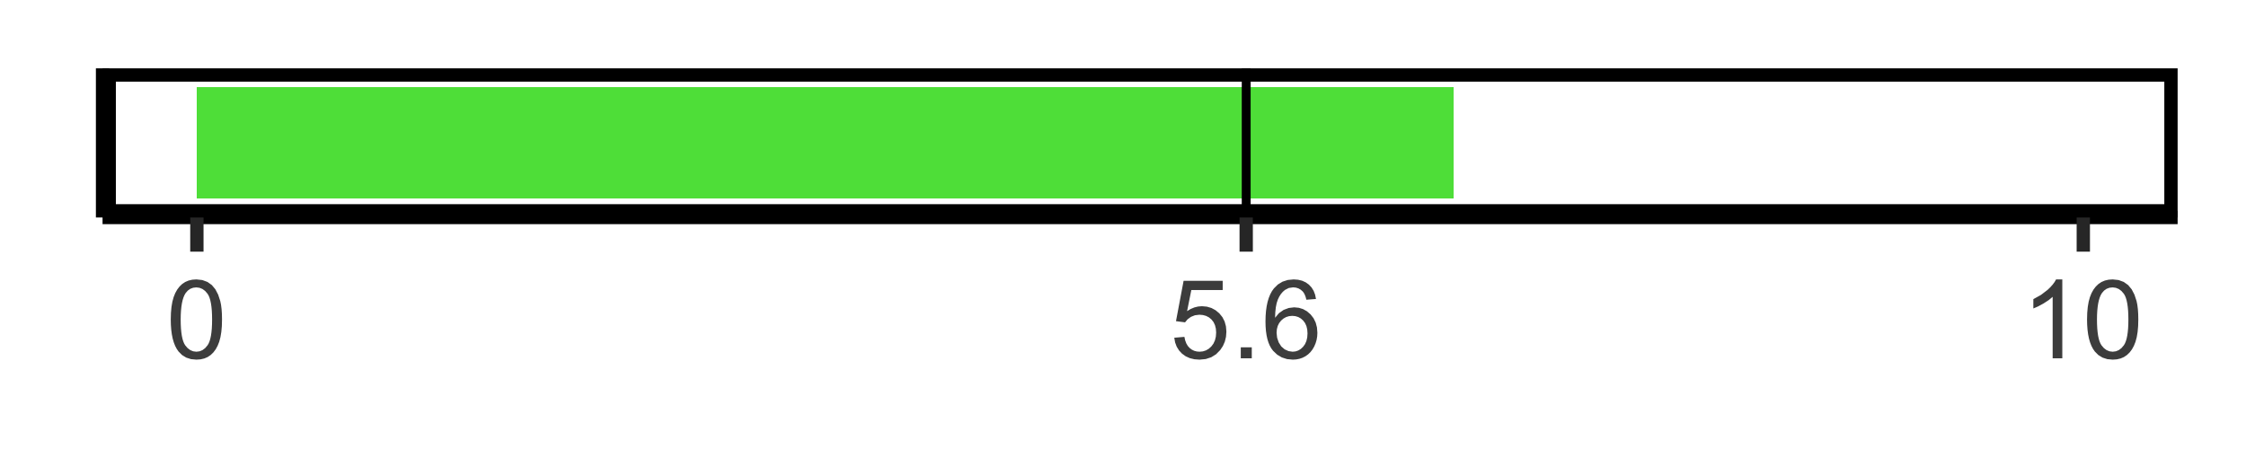
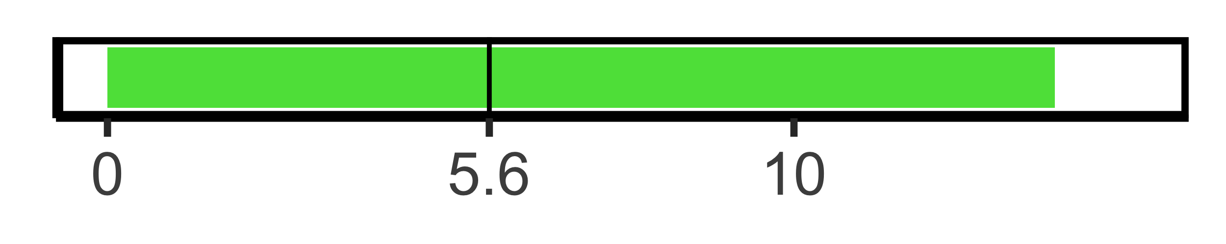
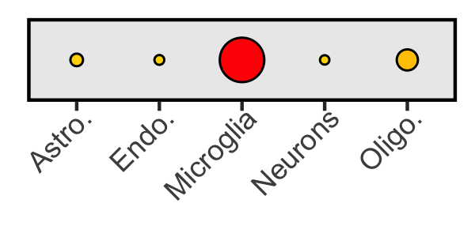
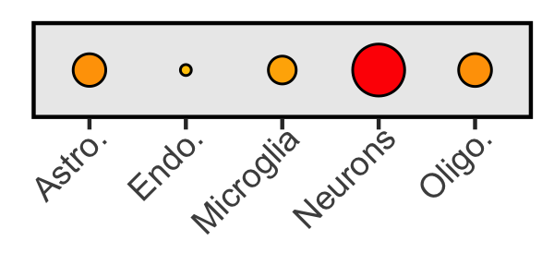
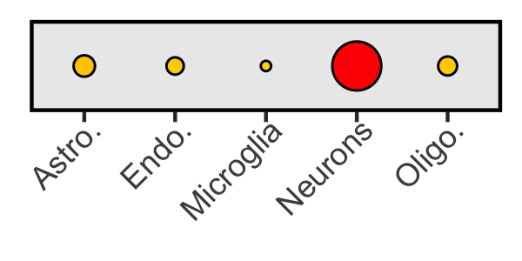
Replicating novel druggable neuropsychiatric genes (Fine-mapping with SuSiEª; PIP>0.9 → replicated)
Background
Methods
Results
Conclusions
Alzheimer’s disease
Amyotrophic lateral sclerosis
Schizophrenia
AD max PIP=1.00
ALS max PIP=1.00
SCZ max PIP=1.00
-log₁₀ SNP P-value
GenT P-value
GenT P-value
GenT P-value
Brain cell gene expression proportions
(ROSMAP^{b})
a: 35853082
b: 29865057
Historical associations
(SYK) Amyloid beta (38712251)
(GAK) Parkinson’s disease (26601739)
(THRB) Cognition (25644384)

Slide 9
Detecting Type 2 diabetes genes across populations (Marginal testing)
Background
Methods
Results
Conclusions
All genes
Druggable genes
269 diabetes-associated genes detected by gene-based testing but missed by GWAS
45 diabetes-associated genes detected by gene-based testing but missed by GWAS
9K
6K
3K
0
2K
1K
0
Detected genes
Detected genes

Slide 10
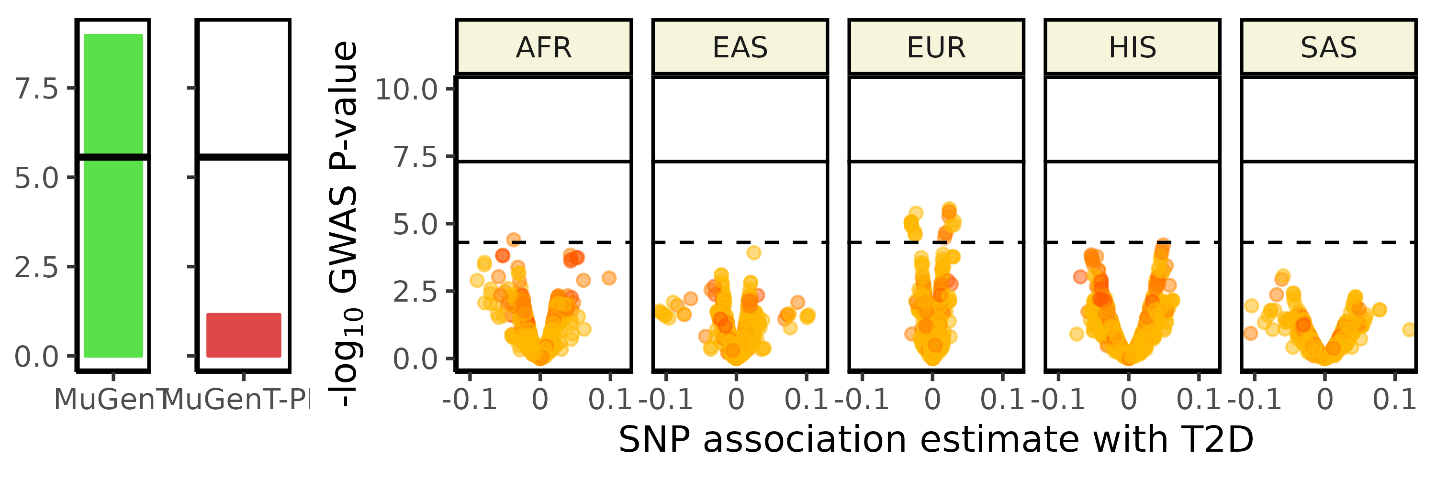
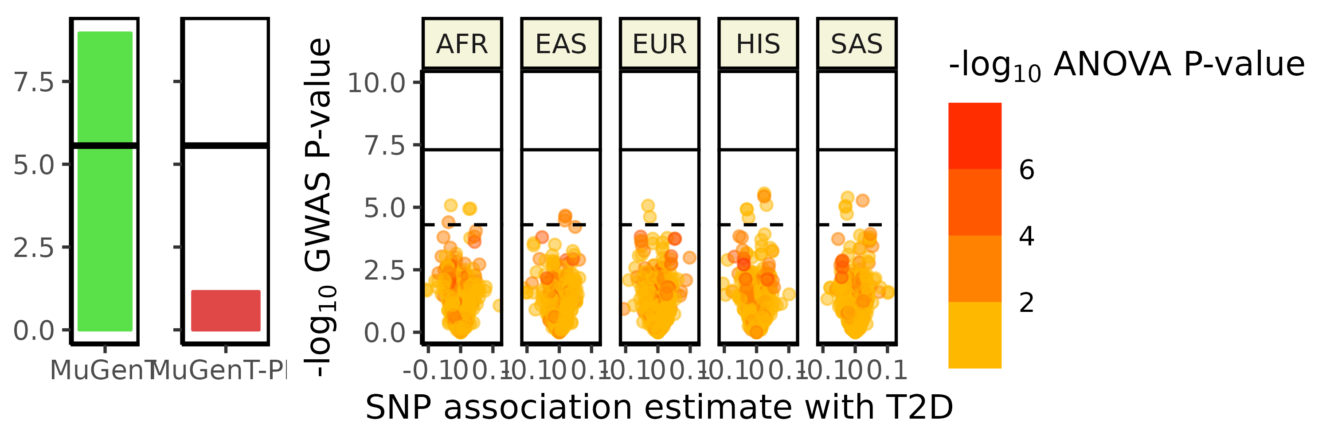
Replicating FKBP5 and Type 2 diabetes (Fine-mapping with SuSiE)
Background
Methods
Results
Conclusions
FKBP5 (6p21.31)
Regulator of glucocorticoid receptor signaling
PIP=0.0
PIP=0.3
PIP=1.0
PIP=0.4
PIP=1.0
-log₁₀ ANOVA P-value
-log₁₀ GWAS P-value
Historical associations
Insulin resistance (24997500)
Hyperlipidemia (29951131)

Slide 11
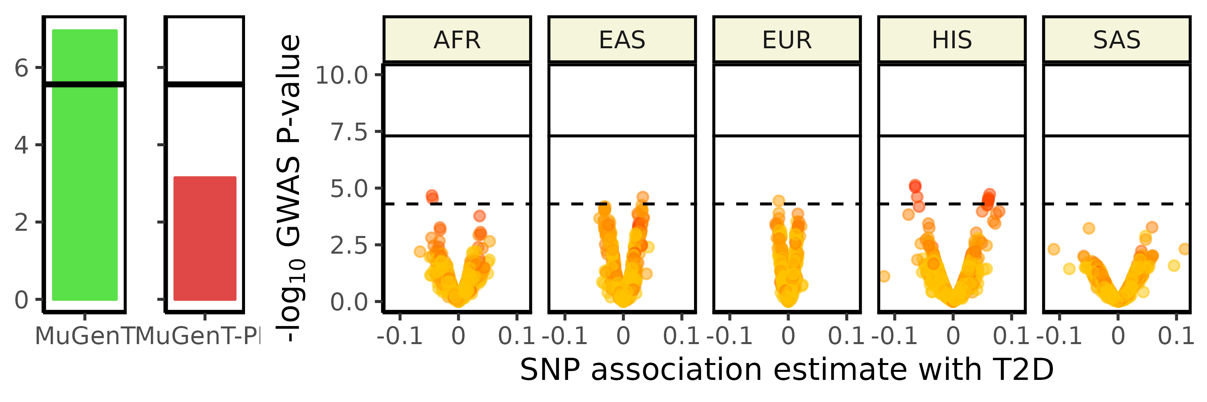
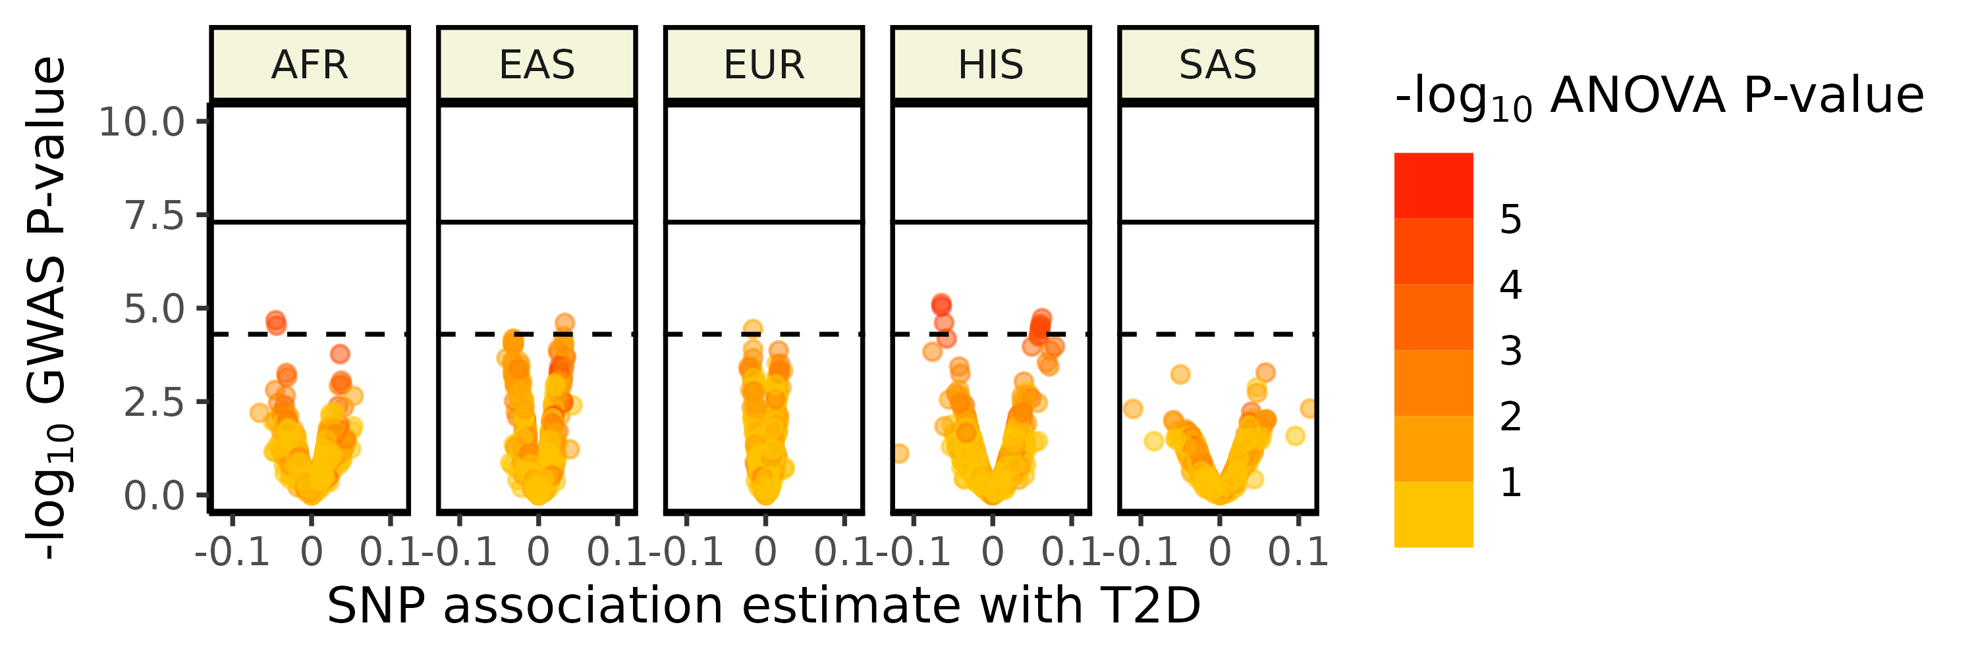
Replicating CDC42BPA and Type 2 diabetes (Fine-mapping with SuSiE)
Background
Methods
Results
Conclusions
CDC42BPA (1q42.13)
Many cellular processes
PIP=0.1
PIP=1.0
PIP=1.0
PIP=1.0
PIP=0.1
-log₁₀ ANOVA P-value
-log₁₀ GWAS P-value
Historical associations
Low-density lipoprotein (33339817)
Inflammation (36303069)

Slide 12
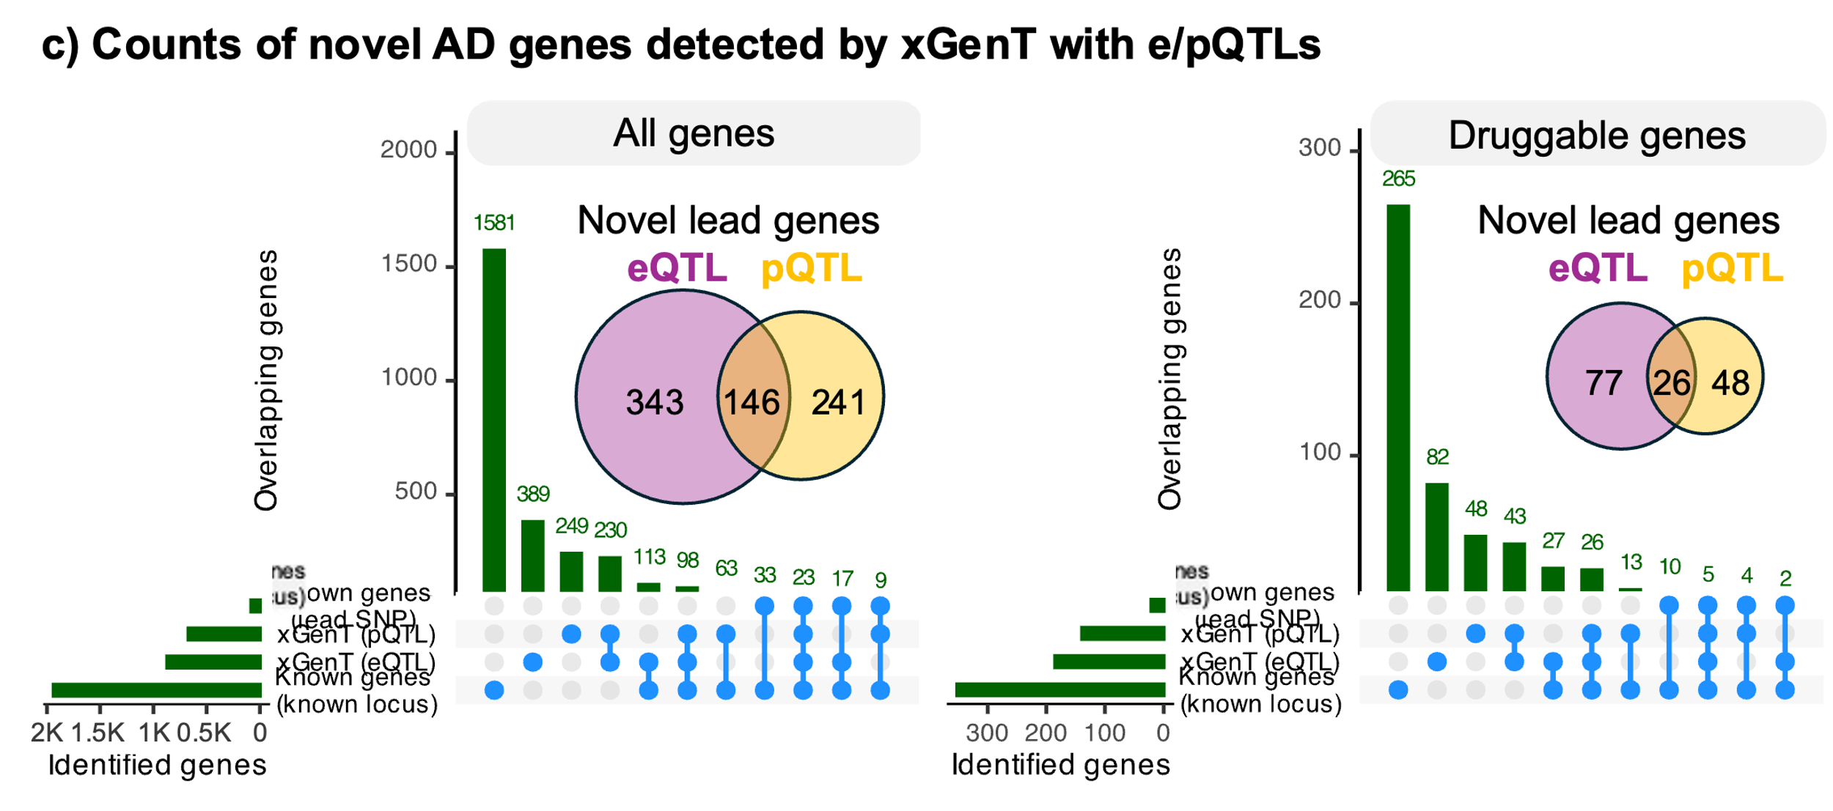
Integrating e/pQTLs to detect Alzheimer’s disease genes
Background
Methods
Results
Conclusions
All genes
Druggable genes
Novel lead genes
Novel lead genes
Gene expression
Protein abundance
Gene expression
Protein abundance

Slide 13
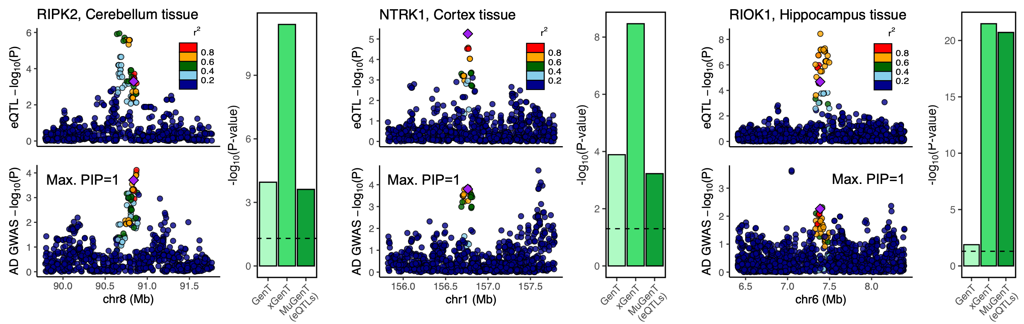
Replicating novel Alzheimer’s disease genes (Fine-mapping with SuSiE)
Background
Methods
Results
Conclusions

Slide 14
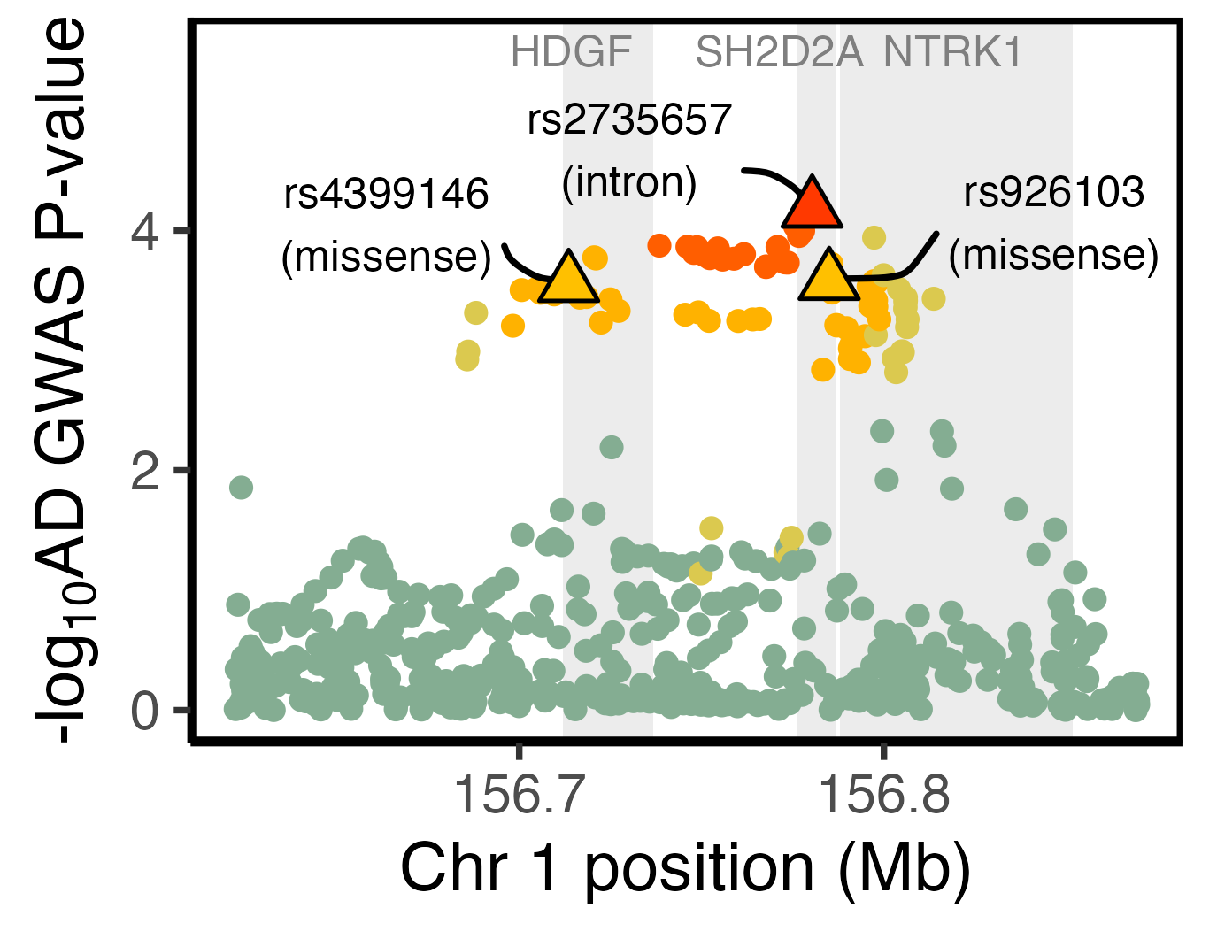
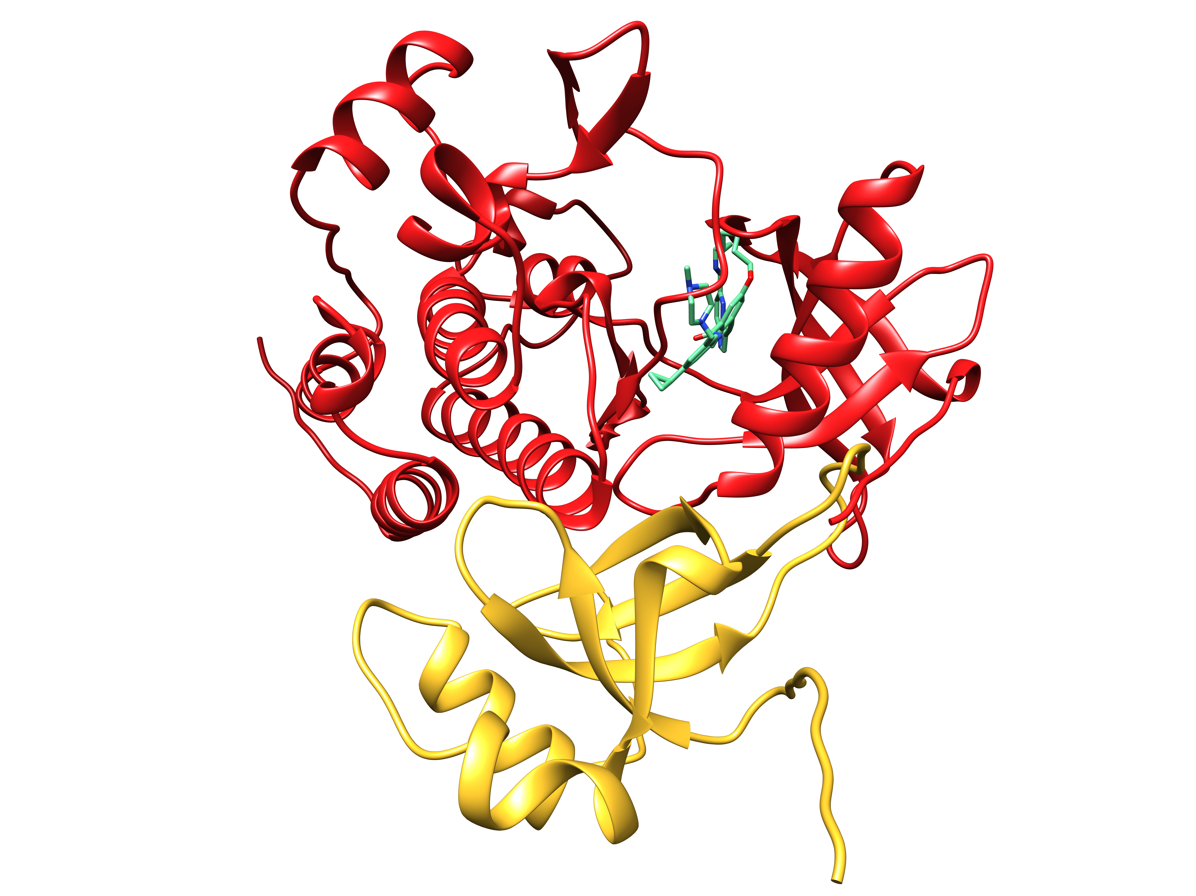
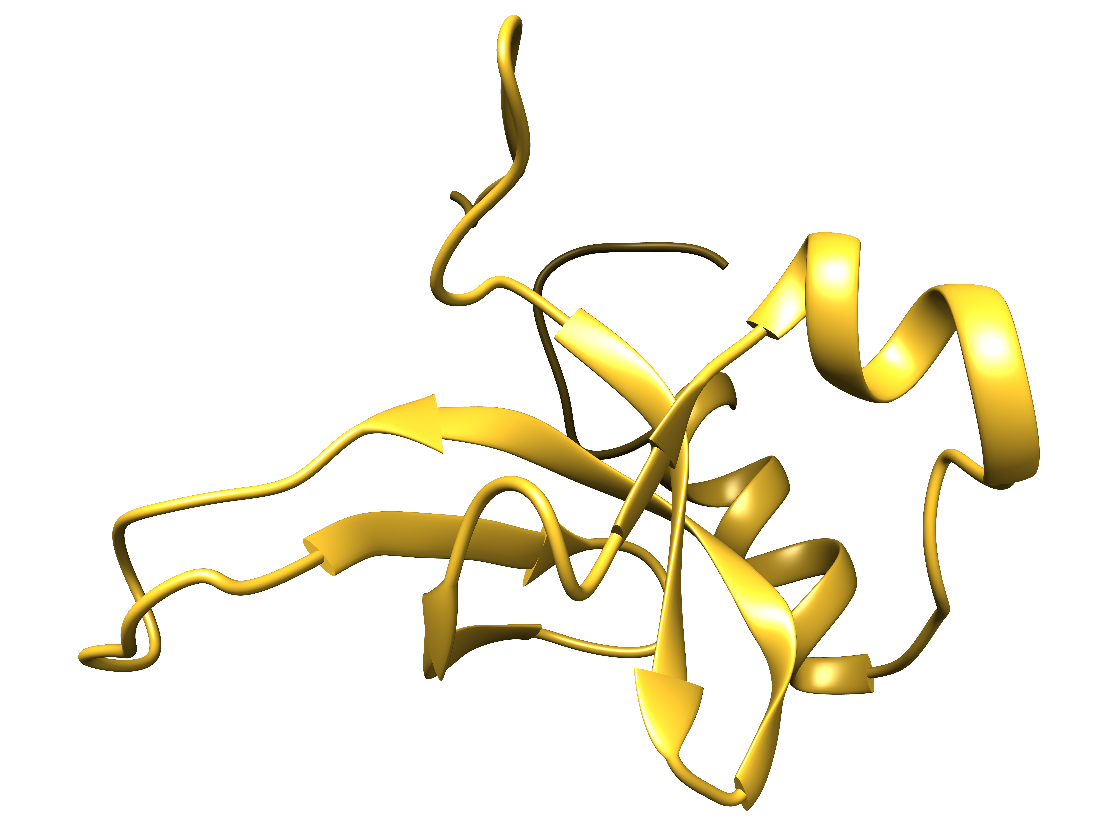
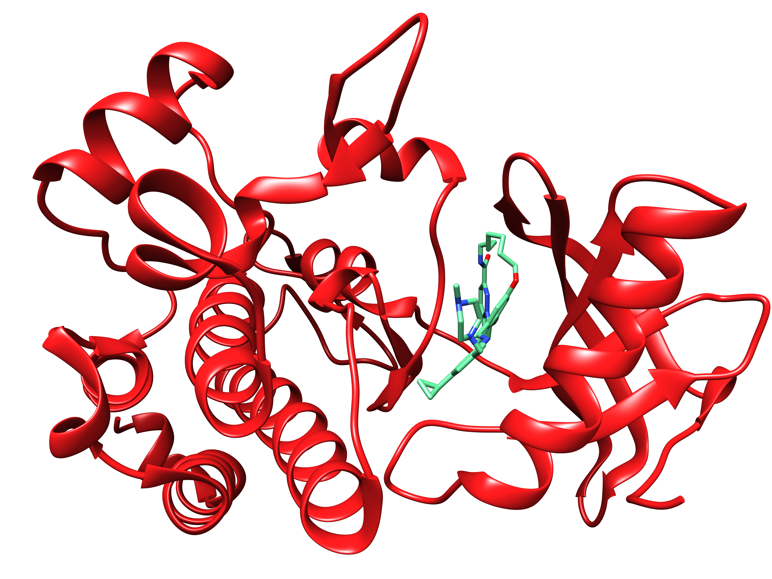
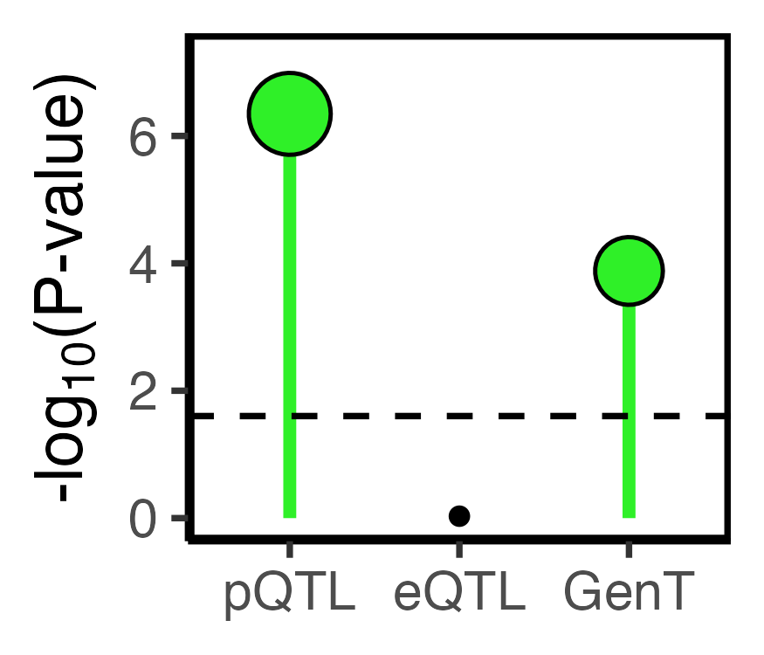
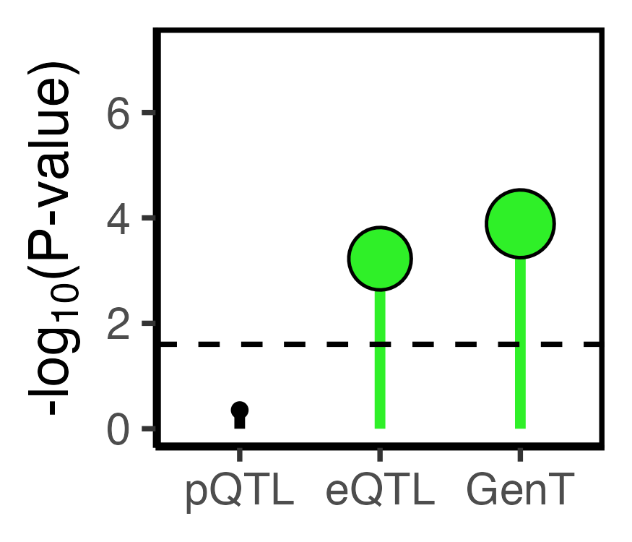
Functional annotation of NTRK1 (SNP annotation, physical protein-protein interaction)
Background
Methods
Results
Conclusions
NTRK1 locus
Physical interaction
HDGF
(druggable)
NTRK1
(druggable)

Slide 15

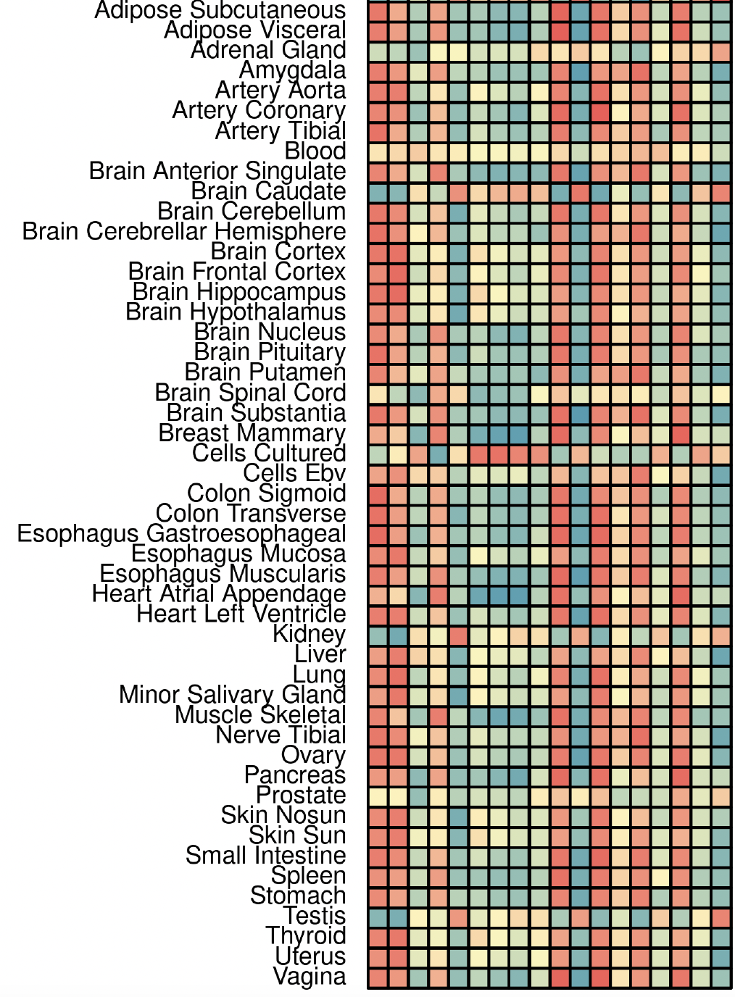


Experimental replication of NTRK1 (Mendelian Randomization)
Background
Methods
Results
Conclusions
Alzheimer’s disease
Positive genetic association between NTRK1 expression and AD risk
NTRK1 inhibitor (GW441756)
0
1
10
20
(μM)
pTau (Thr217)
Genetic correlation
Inhibition of NTRK1 expression in P24 neurons reduces phosphorylated tau levels at 24hr.
pTau (Thr181)
Treatment for 24hr in P24 neurons
Dr. Wenqiang Song (Cheng lab)

Slide 16
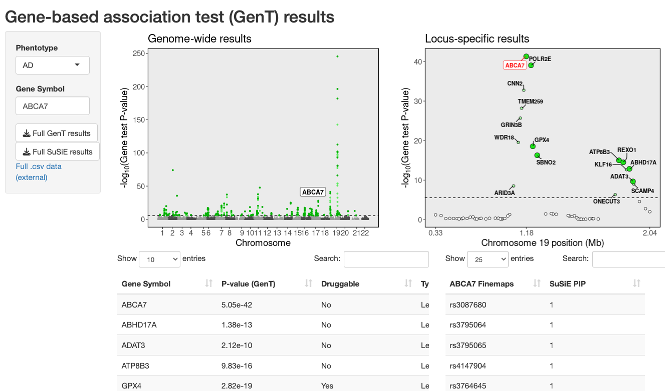
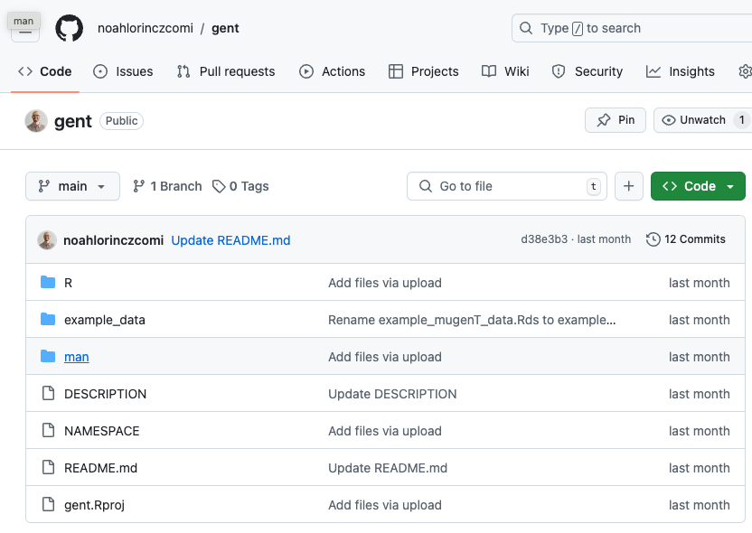
Software
Background
Methods
Results
Conclusions
Database of results for 32 diseases and their replication
https://nlorinczcomi.shinyapps.io/gent/
R package
https://github.com/noahlorinczcomi/gent

Slide 17
Gene-based testing
Background
Methods
Results
Conclusions
Strengths
More powerful than SNP-based gene inference
Our modified tests guarantee controlled Type I error
Multi-ancestry tests most powerful
Leverages shared heritability across populations
Limitations
No known optimal SNP-gene assignment
Cannot infer effect direction

Slide 18
Future applications
Background
Methods
Results
Conclusions
Multi-ancestry tests can also be applied to multiple traits
Good candidates are phenotypically similar traits
Blood pressures
Lipid measurements
Power gained by shared heritability
All methods are based on SNP sets
Gene-specific sets
CpG islands
Functionally homogenous SNPs
More experimental validation of candidate drug targets
Prioritization of candidates based on transcriptomic data

Slide 19

Thank you
Feixiong Cheng’s lab
Marina Bykova
Yichen Li
Wenqiang Song
Xiaoyu Yang
Xin Chen
Zhendong Sha
Zhigang Liu
Zixu Wang
Dhruv Gohel
Isabela Rivera Paz
Maria Rivera Paz
Yuan Hou
Yuxin Yang
William Martin
Diana Zajac
Evangeline White
Yunxiao Ren
Amit Gupta
Yunguang Qiu
Jielin Xu
Reina Kuji
Lijun Dou
Yadi Zhou
Alyssa Hansraj
Cleveland Clinic Foundation Global Center for Pathogen & Human Health Research Postdoctoral Fellowship

